Slide 1

ANTLR v4
Dean Fletcher, Darshan Patel, Charles Read

Slide 2
What is ANTLR?
ANTLR is a parser generator that can be used to read, process, execute, or translate structured text and binary files.
ANTLR will be able to generate a parser that can automatically build parse trees when an established grammar is presented.
ANTLR’s ability to build a data structure and generate code that can walk the tree, we can understand, create, and interpret languages, tools and frameworks.

Slide 3
What we did
For this project, our group decided to use ANTLR to help generate a parser that can build and walk parse trees for an employee database system. We would create a database in which a person\user can input their name, employee ID, date of birth, wage, hours. This will lead us to have a pay and string output of the collection of information.
In our grammar we included lexer and parser rules. With a lexer we developed individual character and transformed them in tokens. For example, we have (STRING: [A-Za-z];) and (INT: [0-9]+;) that will be used to create the employee name and employee ID #. The parser would then utilize these tokens and build expressions from it. For example, (pay: wage TIMES hours;), where a int or double of wage will be multiplied by hours to create a pay value.

Slide 4
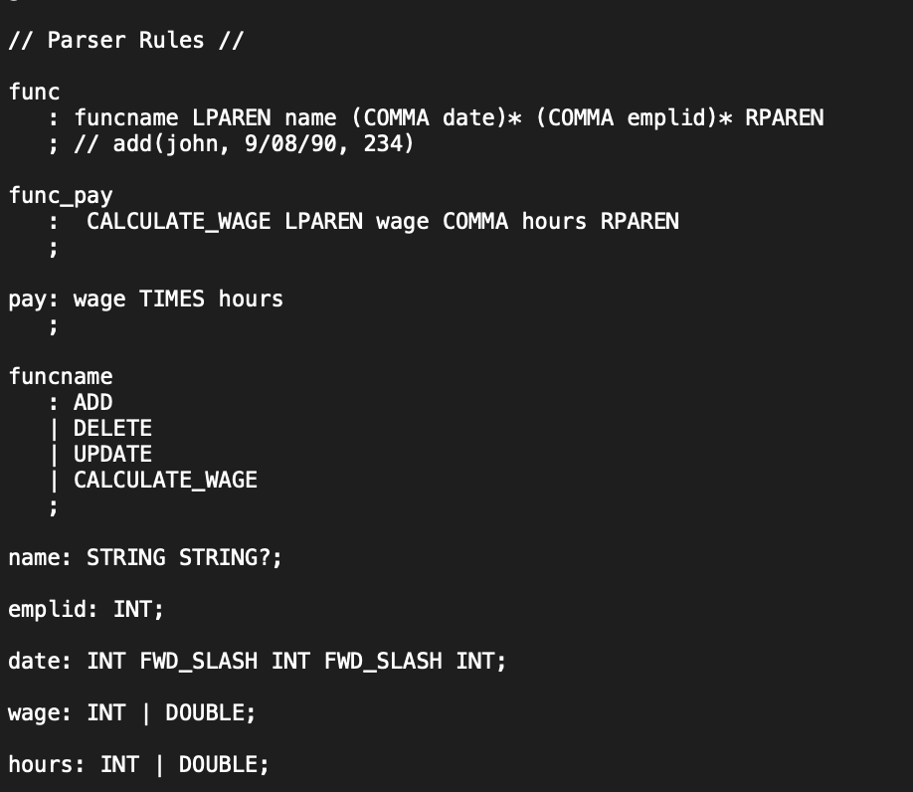
What we did cont...
Parser Rules

Slide 5
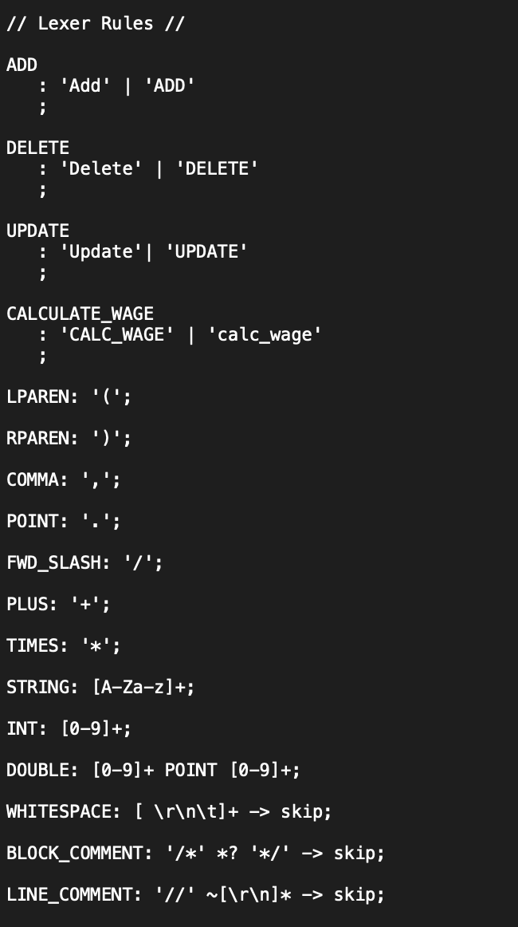
What we did…
Lexer Rules

Slide 6
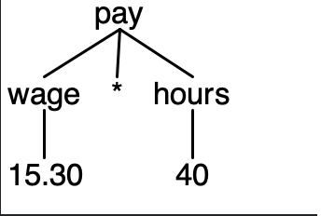
What we did...

Slide 7
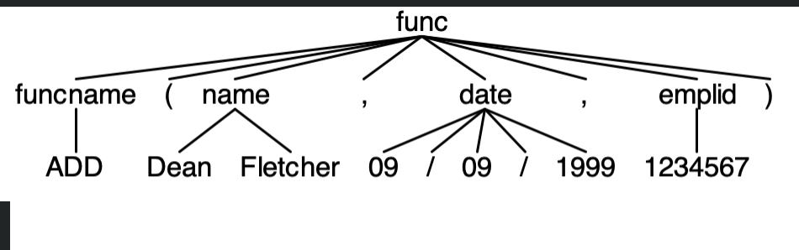
What we did...

Slide 8
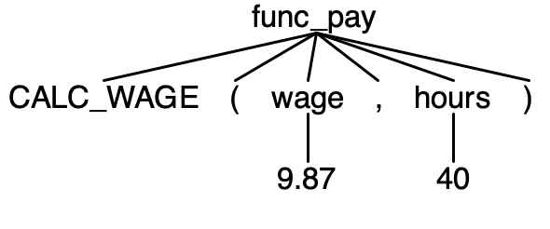
What we did...

Slide 9
What we could change for next time
For any future projects or further development we would like to implement Listeners and Visitors
Utilizing ANTLR on a major project, would be very beneficial.
Listener and Visitor are useful in keeping application-specific code out of grammars, so we have grammars that tend to be easier to read. Visitor methods are more flexible in terms of them being able to return any custom type value.

